Slide 1
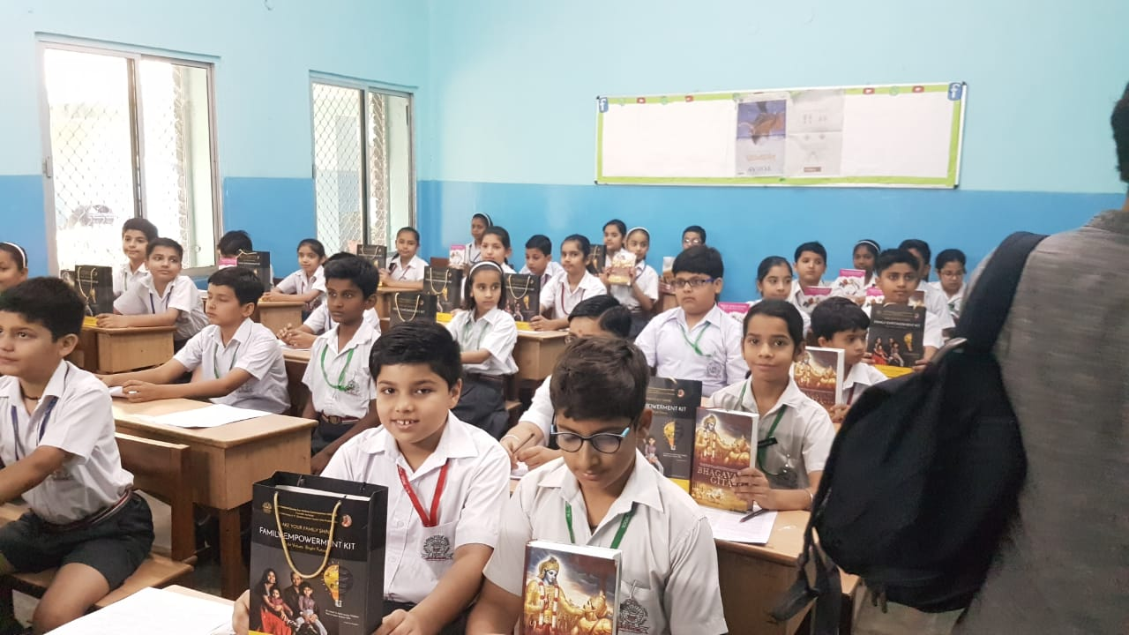
Awareness and Use of Value Education Kit
Empowering Students with Essential Life Skills
By : MRS ARSHINA KHANAM
& MRS ANITA RAWAT
PRT, APS NASIRABAD

Slide 2
Definition of Value Education
Value education is the process of developing moral, ethical, and social values, and the skills and behaviors that go along with an individual for his/her lifetime.

Slide 3
Importance of Value Education in Schools
Value education is important in schools because it helps students develop a strong sense of right and wrong, and promotes qualities such as honesty, integrity, and empathy. These qualities are important for personal growth and for building a harmonious and compassionate society.

Slide 4
What is Value Education Kit?
A value education kit is a resource that teachers can use to help students develop moral and ethical values, and to practice them in their daily lives:
What it includes?
A value education kit typically includes a handbook for teachers and value cards.
How it's used?
Teachers can use the value cards during enrichment periods to present value-based messages through activities like brainstorming sessions and stories.
What it helps with?
The kit helps students develop critical thinking skills and practice values like honesty, integrity, and empathy. It also helps students learn how to make ethical decisions and behave in different situations. Value education is important because it helps students become well-rounded citizens who contribute positively to society. It can also help build civil and democratic societies where people respect each other's rights.

Slide 5
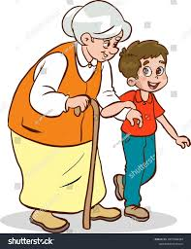
Components of the Kit
Textbooks, activity sheets, posters, placards containing/showing content like :
Respect: Image of a child helping an elderly person
Empathy: Picture of a child comforting a friend

Slide 6
Contd…Components of the Kit
Honesty: Image of a child returning a lost item
Kindness: Photo of a child sharing toys with others

Slide 7
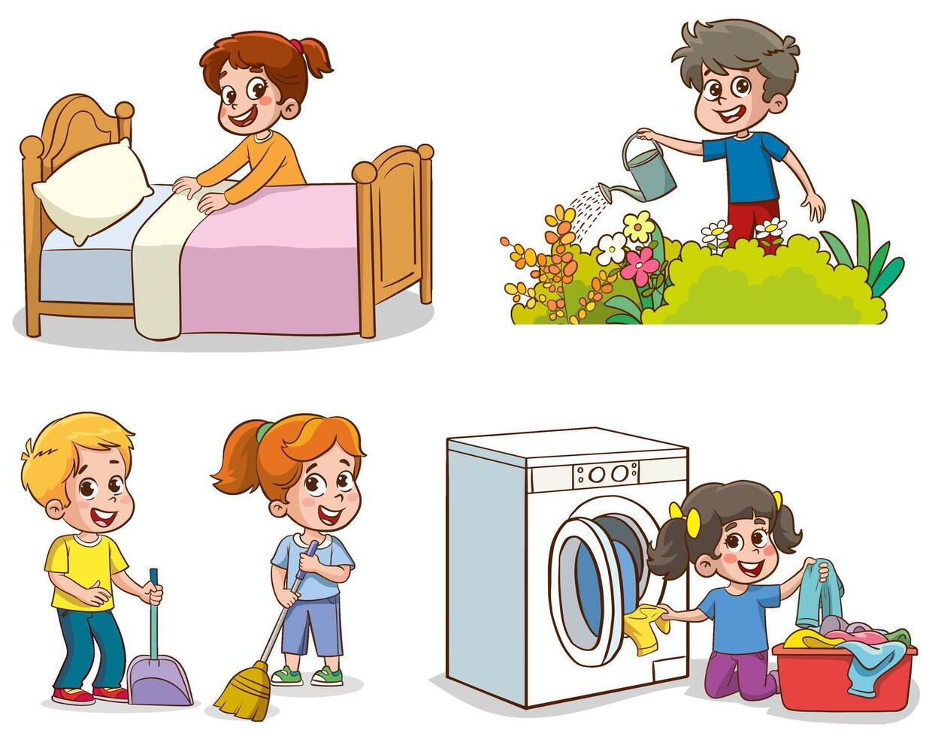
Contd…Components of the Kit
Responsibility: Picture of a child doing chores
Self-Discipline: Image of a child studying with focus

Slide 8
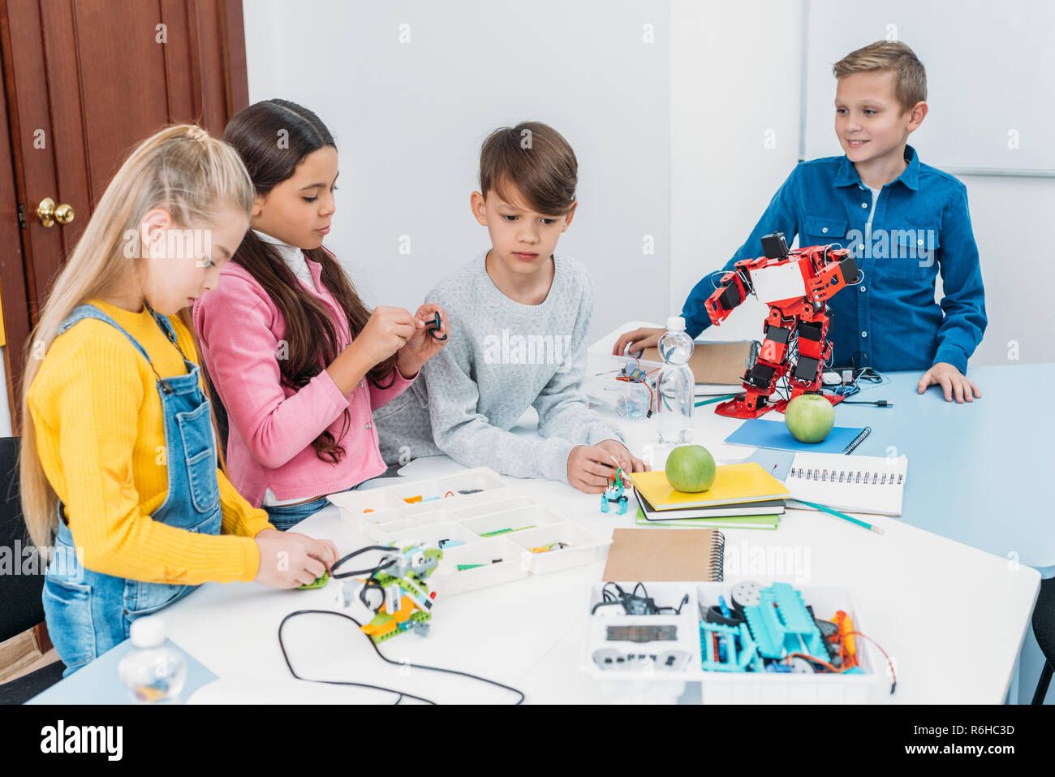
Contd…Components of the Kit
Teamwork: Photo of children working together on a project
Courage: Picture of a child standing up for themselves

Slide 9
Contd…Components of the Kit
Life Skills:1. Time Management: Image of a child using a planner
Courage: Picture of a child standing up for themselves

Slide 10
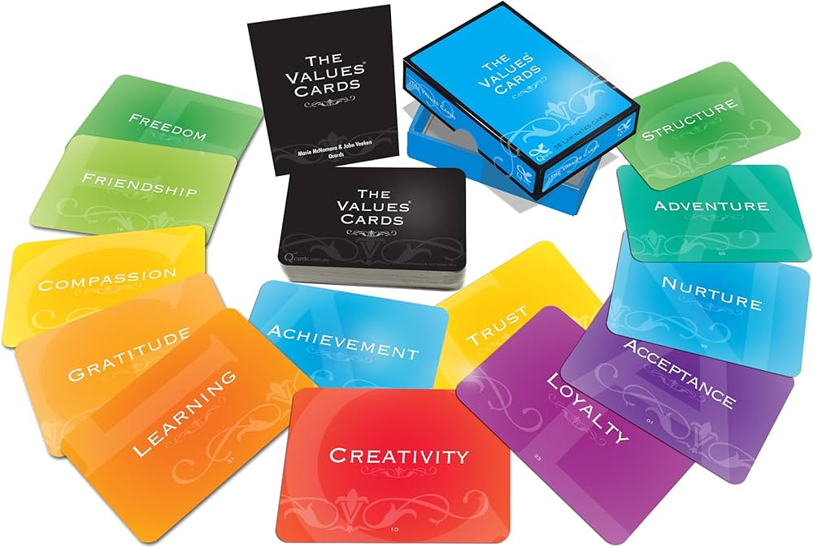
Contd…Components of the Kit
MAINTAINING VALUE CARD

Slide 11
Contd…Components of the Kit

Slide 12
Benefits of Using the Kit
Value Education Kit is essential in schools due to its numerous benefits:
Benefits for Students:
1. Develops moral and ethical values
2. Enhances critical thinking and problem-solving skills
3. Fosters emotional intelligence and empathy
4. Promotes positive relationships and social skills
5. Supports academic achievement and character development
6. Encourages responsible decision-making and citizenship
7. Helps manage emotions, conflicts, and stress

Slide 13
Contd… Benefits of Using the Kit
Benefits for Teachers:
1. Provides structured resources for teaching values
2. Enhances teaching skills and confidence
3. Facilitates classroom management and discipline
4. Encourages student engagement and participation
5. Supports teacher-student relationships

Slide 14
Contd… Benefits of Using the Kit
Benefits for Schools:
1. Creates positive school culture and climate
2. Reduces bullying, violence, and conflicts
3. Improves student behavior and academic performance
4. Enhances school reputation and community involvement
5. Supports inclusive and diverse environments

Slide 15
Contd… Benefits of Using the Kit
Benefits for Society:
Develops responsible, empathetic, and engaged citizens
Promotes social cohesion and community values
Reduces crime, violence, and social problems
Encourages environmental awareness and sustainability
Fosters global understanding and peace

Slide 16
Need for Value Education
The need for value education is paramount in today's world due to various social, cultural, and economic changes. Here are some reasons highlighting the importance:
Social Reasons:
1. Moral decline and erosion of values
2. Increasing crime rates and violence
3. Bullying, harassment, and social exclusion
4. Breakdown of family structures and relationships
5. Growing individualism and decreasing empathy
Cultural Reasons:
1. Globalization and cultural diversity
2. Changing social norms and values
3. Influence of media and technology
4. Loss of traditional values and customs
5. Need for cultural sensitivity and understanding

Slide 17
Need for Value Education
Educational Reasons:
1. Holistic development of students
2. Integration of values with academics
3. Preparation for responsible citizenship
4. Development of critical thinking and problem-solving skills
5. Enhancement of emotional intelligence and well-being
Personal Reasons:
1. Building self-awareness and self-esteem
2. Developing resilience and coping skills
3. Forming positive relationships and friendships
4. Making informed life choices and decisions
5. Cultivating a sense of purpose and meaning

Slide 18
Benefits of Value Education
1. Develops moral character and ethical decision-making
2. Enhances emotional intelligence and empathy
3. Fosters responsible citizenship and community involvement
4. Promotes academic achievement and personal growth
5. Supports mental health and well-being
Key Values to Focus On:
1. Respect, empathy, and compassion
2. Honesty, integrity, and trustworthiness
3. Responsibility, accountability, and self-discipline
4. Fairness, justice, and equality
5. Courage, resilience, and perseverance
By incorporating value education into our schools and communities, we can empower individuals to become responsible, ethical, and compassionate citizens, leading to a more harmonious and sustainable society.

Slide 19
Awareness of Value Education Kit
Here's a comprehensive plan to create awareness about the Value Education Kit:
Objective: To inform and educate stakeholders about the Value Education Kit and its benefits.
Strategies:
I. Pre-Launch
1. Conduct surveys and focus groups to understand existing value education practices.
2. Identify key influencers and opinion leaders in education.
3. Develop promotional materials (posters, brochures, videos).
II. Launch Event
1. Organize a launch event for educators, administrators, and media.
2. Showcase kit contents, benefits, and success stories.
3. Invite guest speakers (experts, educators, or policymakers).

Slide 20
Contd.. Awareness of Value Education Kit
III. Training and Workshops
1. Provide teacher training and workshops on kit implementation.
2. Offer online webinars and tutorials.
3. Collaborate with educational institutions for kit integration
IV. Digital Campaign
1. Create a dedicated website and social media channels.
2. Share engaging content (videos, testimonials, infographics).
3. Utilize hashtags and tag influencers.

Slide 21
Effective Implementation Strategies
Here are effective implementation strategies for the Value Education Kit in schools:
Pre-Implementation
1. Teacher Training: Provide comprehensive training on kit contents, objectives, and implementation strategies.
2. Needs Assessment: Conduct surveys to identify school-specific needs and priorities.
3. Stakeholder Engagement: Involve administrators, teachers, parents, and students in kit planning and implementation.
Implementation
1. Integration with Curriculum: Embed value education into existing subjects (e.g., character education, social studies).
2. Flexible Delivery: Use various teaching methods (lectures, discussions, role-plays, group work).
3. Student-Centered Approach: Encourage active participation, reflection, and self-assessment.
4. Storytelling and Real-Life Examples: Use relatable stories and examples to illustrate values.
5. Visual Aids and Multimedia: Utilize posters, videos, and interactive materials.

Slide 22
Effective Implementation Strategies
Institutional Strategies
1. Establish a Value Education Committee.
2. Develop a Value Education Policy.
3. Allocate Resources (time, budget, personnel).
4. Integrate Value Education into School Culture.
5. Recognize and Reward Positive Behavior.
Teacher Strategies
1. Create a Positive Learning Environment.
2. Use Varied Teaching Methods.
3. Encourage Student Reflection.
4. Provide Feedback and Guidance.
5. Model Desired Values.

Slide 23
Effective Implementation Strategies
Student Strategies
1. Encourage Active Participation.
2. Foster Peer Support and Responsibility.
3. Develop Self-Awareness and Reflection.
4. Provide Opportunities for Service Learning.
5. Celebrate Student Achievements.
Parent Strategies
1. Engage in Open Communication.
2. Support School Values.
3. Model Desired Values at Home.
4. Participate in School Events.
5. Provide Positive Reinforcement.
By implementing these strategies, schools can effectively integrate the Value Education Kit into their curriculum, fostering a positive and supportive learning environment.

Slide 24
THANK YOU

